Slide 1
The 8th CLA Global TS Business Plan Challenge 2025

Slide 2
Round 1 & Round 2 Admin Slide
PIC 1: Name, Email Address: | Utkarsh Raj Sutihar 1008039@mymail.sutd.edu.sg | School, Mobile No. | Singapore University of Technology and Design +65 86238301
PIC 2: Name, Email Address: |  | School, Mobile No.
Team Members’ Name (max Team of 5)
Title of Business Plan | Cashket – Cashflow AI
Business Plan Summary: Cashket is an AI-powered cash flow intelligence tool built for Singaporean SMEs facing rising cost pressures and trade uncertainties. It connects with existing tools and database like Excel, automates invoice processing using LLM-based OCR, and provides real-time analytics, cash gap alerts, and follow-up actions—no finance or technical expertise needed. With a hybrid pricing model (affordable SaaS for small firms and full-system deployment for privacy-sensitive clients), Cashket addresses a market of over 147K SMEs across logistics, retail, and manufacturing. Its modular tech stack enables rapid 12-month deployment, and projected breakeven is between Q2–Q3 of Year 1. Cashket stands out with contextual AI agents, privacy-preserving design, and 80–85% SaaS margins—making it a timely solution with strong financial sustainability.

Slide 3
THE 8TH CLA GLOBAL TS BUSINESS PLAN CHALLENGE 2025
Utkarsh Raj Sutihar
CASHKET
The Treasure Box for All Your Cash Flow
Slide 01 - Cashket

Slide 4
Cashket
Utkarsh Raj Sutihar
The Urgency: Cash Flow Crisis in SMEs
Singapore’s Small Business Cash Crunch Drives Owners To Forego Salary
Singapore Firms Struggling With Cash Flow Amid US Tariffs
Slide 02 - Problem Validation

Slide 5
Cashket
Utkarsh Raj Sutihar
What the Numbers Say
83%
SMEs REPORTED CASHFLOW ISSUES
Delayed Payments Across the Supply Chain
41%
Due to trade uncertainities, late payments have become a chronic issue for small businesses in Singapore, with many SMEs forced to wait far beyond agreed terms. This delay disrupts downstream payments, making it difficult for companies to pay suppliers, staff, and fixed overheads on time. The knock-on effect stalls business operations and damages trust in the value chain.
HAD TO RENEGOTIATE SUPPLIER TERMS
19%
Cash Flow Uncertainty Hindering Growth
Owners Sacrificing Salaries to Survive
More than 80% of SMEs report struggling with cash flow in the past year. This uncertainty prevents them from hiring, investing in new capabilities, or expanding. With no visibility into future liquidity, business decisions are reactive and defensive rather than strategic and growth-driven.
USED PERSONAL SAVINGS
A significant number of small business owners have resorted to skipping or reducing their own salaries just to keep their companies afloat. This self-sacrifice is a direct consequence of irregular cash flow and highlights how deeply cash shortages are affecting even the most committed entrepreneurs.
Slide 03 - Problem Context

Slide 6
Cashket
Utkarsh Raj Sutihar
PROBLEM STATEMENT
How might we empower Singaporean SMEs to stay financially agile in 2025 amidst rising trade and cost pressures by using an AI-powered solution that predicts cash flow disruptions, flags payment risks, and enable faster, smarter financial decisions?
Slide 04 - Problem Statement

Slide 7
Cashket
Utkarsh Raj Sutihar
INTRODUCING CASHKET
Cashket is an AI-powered cash flow intelligence tool that helps SMEs predict disruptions, assess payment risks, and make smarter financial decisions—before problems hit.
Cashket - The Treasure Box for All Your Cash Flow
Step 1
Connect
Cashket integrates with your existing database and accounting tools to fetch transaction and invoice data.
Step 2
Predict & Analyse
Our AI forecasts cash flow trends, flags delayed payment risks, and scores client reliability using historical patterns.
Step 3
Act Smart
Receive proactive alerts and AI-driven recommendations to renegotiate terms, delay spending, or bridge gaps—before it’s too late.
Slide 05 - Solution Outline

Slide 8
Cashket
Utkarsh Raj Sutihar
USER JOURNEY
From Stress to Simplicity
1
“I track payments and stock manually. It’s easy to miss late invoices.”
“I waste time checking who still hasn’t paid us this month.”
2
“I can’t afford to miss supplier payments, or stock gets delayed.”
Ms Mei Tan values innovation and frequently tries new technology that she thinks could be impactful. She saw Cashket in a startup pitch, liked the idea and decided to give it a try for her company. It was easy to adapt and required no setup.
“We don’t have real forecasts — it’s mostly guesswork.”
Name: Tan Hui Ling
Age: 38
Company: Mei Tan Wholesale - SME
Tech Comfort: Moderate – uses Excel and WhatsApp daily
Location: Ang Mo Kio, Singapore
Finance and Inventory Coordinator
3
Now Hui Ling never needs to manually track any payment. She just takes a picture of the invoice through her Cashket app and entry and timeline tracking are handled by the app. This has made her life comparatively easier.
Slide 06 - User Journey (Stress)

Slide 9
Cashket
Utkarsh Raj Sutihar
USER JOURNEY
6
Cashket helps her flag risky clients with a Client Risk Score based on their payment history and patterns.
She also gets a chatbot that can directly answer any of her query regarding her invoices and cashflows in natural language.
4
She gets real time analysis of cash flow of her project. She also gets forecast of future cash flows based on current invoices and client payment patterns.
5
Cashket alerts Hui Ling of Cash gaps and suggests bridging methods like invoice financing.
It also send professional mails to clients whose invoice payments are due.
Tan Hui Ling’s life is much easier now, with a lot of workload and stress off her mind. She is very happy and Mei Tan is very happy from her employee’s efficiency.
This financial year Mei Tan Wholesale saw 180% increase in revenue.
7
Slide 07 - User Journey (Satisfaction)

Slide 10
Cashket
Utkarsh Raj Sutihar
AI Architecture
DATA INGESTION LAYER
DATABASE
AI ENGINE
Raw Database of all entries
Parsed Invoice Category Data
Vector Embeddings
Locally run LLM
Existing Client Database with Historical Data
MACHINE LEARNING PIPELINE
CHATBOT AND DASHBOARDS
AGENT TASKS AND RECOMMENDATIONS
Invoice Type Categorization
Interactive Chatbot
with contextual knowledge and memory
Follow-up Message
Timeline Tracker
New invoice image scan/upload
- Processed through OCR
Cash Flow Forecasting
Real-Time Cashflow Analytics
Bridging Suggestions
Client Risk Scoring
Slide 08 - AI Architecture

Slide 11
Cashket
Utkarsh Raj Sutihar
Competitive advantage
“The only AI-first, mobile-friendly finance tool made for SMEs in Singapore that handles everything from receipt scanning to cash gap forecasting — with zero finance expertise required.”
 | Invoice Financing | SME Focused Design | Real-Time Cash Flow Analytics | Predictive Cash Flow Forecasting AI | Contextual AI Chatbot | AI Agent Tasks (like auto follow-up emails) | Smart Invoice Timeline Tracker | Privacy-Preserving Deployment
InvoiceInterchange | ✅ | ✅ | ❌ | ❌ | ❌ | ❌ | ❌ | ❌
Funding Societies | ✅ | ✅ | ❌ | ❌ | ❌ | ❌ | ❌ | ❌
Hubble.Financial | ✅ | ✅ | ❌ | ❌ | ❌ | ❌ | ❌ | ❌
Aspire | ❌ | ✅ | ✅ | ❌ | ❌ | ❌ | ❌ | ❌
Cashket | ⚠️ (via partners) | ✅ | ✅ | ✅ | ✅ | ✅ | ✅ | ✅ (hybrid)
Competitive Advantage: Multi-Component AI Pipeline (receipt parsing → analysis → forecasting → RAG-based LLM agents)
Slide 09 - Market Competition

Slide 12
Cashket
Utkarsh Raj Sutihar
Feasibility & Risks assessment
Market Enablers
Threats and Barriers
Delayed Payments Create Urgency: Cash flow issues and supply chain delays make forecasting tools like Cashket immediately relevant.
Lack of Full-Time Finance Teams: Cash-strapped SMEs rely on easy-to-use AI solutions for decision support—Cashket fills this gap.
Modular Tech Allows Fast Build: Using existing OCR, ML, and LLM tools, the product can be deployed rapidly without building from scratch.
Lean Go-to-Market Strategy: Early outreach, product-led growth, and SME partnerships can accelerate adoption within 12 months.
Focused Target Market: The clearly defined niche (Singaporean SMEs in logistics/retail/manufacturing) allows concentrated sales and tailored development—accelerating initial traction.
Pre-validated Tech Stack: OCR, invoice parsing, forecasting models, and LLM-based agents are already production-tested technologies—reducing R&D time and risk.
SME Budget Sensitivity: Cost-conscious businesses may delay or reject new software subscriptions despite long-term benefits.
Macroeconomic Instability: Trade-related uncertainties and import/export slowdowns may impact client operations and payments.
Procurement Delays in Larger Firms: Privacy-sensitive enterprises may take longer to approve and integrate full system deployments.
Crowded Fintech Market: Competitors like Aspire may replicate features or undercut on price before full traction.
Data Policy & Compliance Risks: AI regulations, especially regarding invoice data and local server usage, could slow deployment.
Slide 10 - Feasibility and Risks Assessment

Slide 13
Cashket
Utkarsh Raj Sutihar
Market Opportunity &
Validation
Cashket operates in the SME financial technology market, focusing specifically on the cash flow intelligence and automation segment. This market addresses the pain point of managing working capital, delayed payments, and inefficient manual finance operations — a challenge that affects a large proportion of small and medium businesses in Singapore and Southeast Asia.
Cashket is designed for:
SMEs in Singapore with 5–100 employees
Operating in sectors like wholesale, logistics, retail, and light manufacturing
Typically don’t have full-time finance teams
Use basic tools like Excel, PDFs, and WhatsApp for invoicing
Prefer mobile-first, easy-to-use platforms
These users value simplicity, accuracy, and automated decision support.
Slide 11 - Market Opportunity

Slide 14
Cashket
Utkarsh Raj Sutihar
Market Opportunity &
Validation
300K+
SMEs in Singapore, contributing to almost 50% of GDP
S$1.26M
ARR assuming 1% market penetration in 1 year
147K+
SMEs in Manufacturing, Retail, Storage and Wholesale sector
Slide 12 - Market Validation

Slide 15
Cashket
Utkarsh Raj Sutihar
Promotional Strategy
Founder-Led Outreach to Early Adopters
Partner with SME Ecosystem Players
Product-Led Growth
Content & SEO Strategy
On-ground Validation at SME Events
Target: SME owners in logistics, retail, and light manufacturing
Channel: LinkedIn direct messaging, Telegram groups, startup meetups
Tactic: Pitch Cashket as an AI assistant for cash flow without finance knowledge
Offer: Free 1-month trial or “Beta Access” with white-glove onboarding
Targets:
Accounting tool providers
SME banks & invoice financiers
Government-backed SME initiatives
Tactic: Co-market through webinars, bundled offerings, or grants alignment
Tactics:
In-app referral program: “Invite 3 SME friends, get 2 months free”
Gamified onboarding: Rewards for uploading 1st receipt, linking account
Contextual nudges: “Want to avoid a cash gap like last month? Enable alerts”
Content Pillars:
“How to Manage Cash Flow without a Finance Team”
“Singapore SMEs & Payment Delays: What You Can Do”
“Why Excel Isn’t Enough for Modern SMEs”
Format: Case studies, video demos, blog, founder insights on LinkedIn
Sponsor or demo at local events:
Accounting & Finance Show Asia, SFF x SWITCH, SMEICC
Set up a “Cash Flow Checkpoint” booth for real-time diagnostic demo
Slide 13 - Promotional Strategy

Slide 16
Cashket
Utkarsh Raj Sutihar
Subscription-Based Model
Target: Small to mid-sized companies (<50 employees) with limited internal tech capability
Model: Cloud-hosted SaaS platform (monthly/ annual plans)
Tiers:
Starter (S$39/month): Up to 200 invoices, full analytics dashboard + alerts
Growth (S$69/month): Starter + Unlimited uploads, AI forecasting, contextual chatbot
Pro (S$119/month): Growth + Includes integrations, team access, AI Agents
Distribution: Available through Cashket website, SME partner platforms, and integrated marketplaces (e.g. App Store, Playstore)
Pricing and Distribution
Hybrid Model
Full System Deployment
Target: Larger enterprises or privacy-sensitive firms (>= 50 employees)
Model: One-time setup fee (S$1999) + annual maintenance (S$199) + optional model customisation
What’s Included:
Full AI stack deployed on client’s hardware or dedicated secure server
Client data never leaves their environment
Technical support and updates via service contract
Distribution: Direct sales via founder outreach, B2B leads from events, or white-labeled enterprise partnerships
Slide 14 - Pricing and Distribution

Slide 17
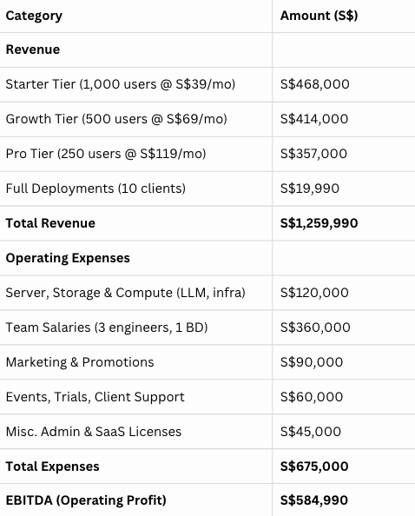
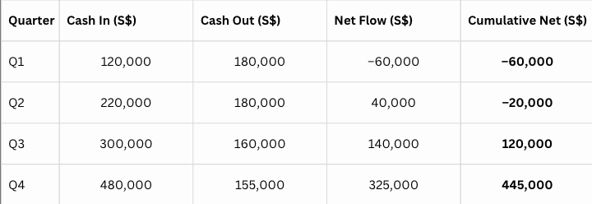
Cashket
Utkarsh Raj Sutihar
Financial Statements
Projected Financial Summary (Year 1)
Projected Cash Flow (Quarterly, Year 1)
Breakeven projected in Q2–Q3 of Year 1
80–85% gross margin on SaaS model
Subscription revenue supports stable cash inflow
Full deployment sales are high-margin boosters
Slide 15 - Financial Statements

Slide 18
Cashket
Utkarsh Raj Sutihar
Thank You
Contact me
1008039@mymail.sutd.edu.sg
Social Media
linkedin.com/in/sutihar
Know More
sutihar.com

